Slide 1

Analyse Customer Review Data to Uncover Findings for British Airways

Slide 2
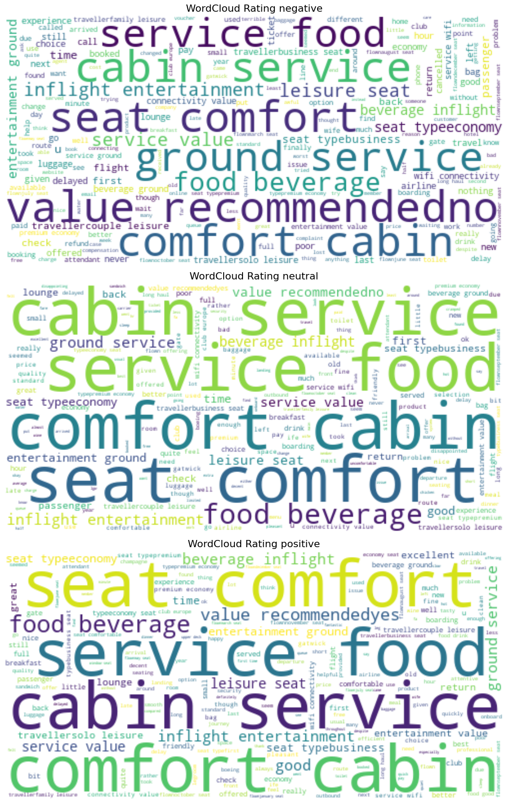
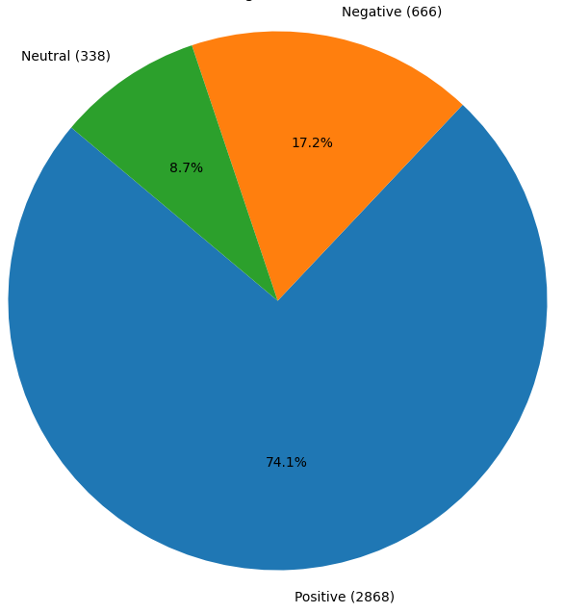
Word Cloud Of Keywords Used In Reviews
Sentiment Analysis
From cleaning 3872 reviews given by the customers, we obtained
Positive Reviews - 2868
Negative Reviews - 666
Neutral Reviews – 338

